Slide 1
SSW345 Model-Based Software Engineering
Web Basics
Prof. Ye Yang
Materials adapted from Prof. Christopher Parnin

Slide 2
Anatomy of a Webpage
Static
Dynamic - (Browser Runtime)
HTML
Document Object Model
CSS
Whenever, a document requested from server and rendered by browser.
CSS Rules
Scripts
Block and Inline Elements
Javascript Sandbox

Slide 3
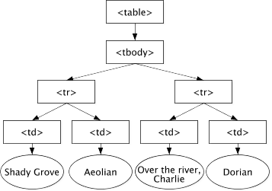
Document Object Model (DOM)
<table>
<tbody>
<tr>
<td>Shady Grove</td>
<td>Aeolian</td>
</tr>
<tr>
<td>Over the River, Charlie</td>
<td>Dorian</td>
</tr>
</tbody>
</table>
The DOM is a programming API for documents.
JavaScript libraries such as jQuery, allow easy manipulation of a DOM structure.

Slide 4
Element Flow
Inline elements flow left to right until no space.
Blocks generally start on new line.
Do not place blocks inside of inline elements.
<span>s</span><span>p</span><span>a</span><span>n</span>
<div>a</div>
<div>e</div>

Slide 5
Cascading Style Sheets (CSS)
CSS allows separating content from style.
A CSS rule has a selector and declaration.
A selector matches a DOM element using a pattern. A declaration sets element’s property.
h1 { color: red }
.redtext { color: red }
<span class="redtext”>test</span>
HTML

Slide 6
Exercise - 1
https://codepen.io/ye_yang/pen/MWwGjpR
Change Bob to have green bold text.
Change it so that only the <li> text is red, not everything in div.
Have <ul> have a box with a border/frame.
Notes:
In CSS: #name{ color:gold}
In HTML: <span id="name"><b>Bob</b></span>
In HTML: Move class="children” from <div> to <li>
In CSS: add ul { border: 1px solid black; }

Slide 7
Less
Less is a CSS pre-processor
  it extends the CSS language
    adding features that allow variables, mixins, functions, and
    Adding many other techniques that make CSS more maintainable, themable, and extendable.
// Variables
@link-color: #428bca; // sea blue
@link-color-hover: darken(@link-color, 10%);
// Usage
a,
.link {
color: @link-color;
}
a:hover {
color: @link-color-hover;
}

Slide 8
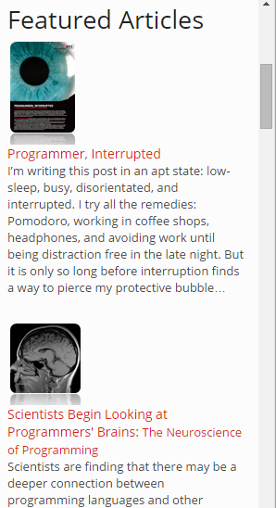

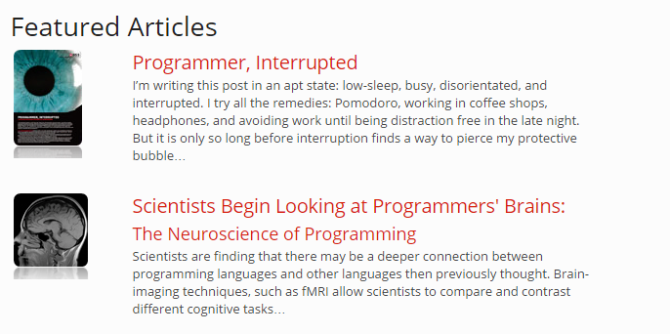
Responsive Design
Small
Medium

Slide 9
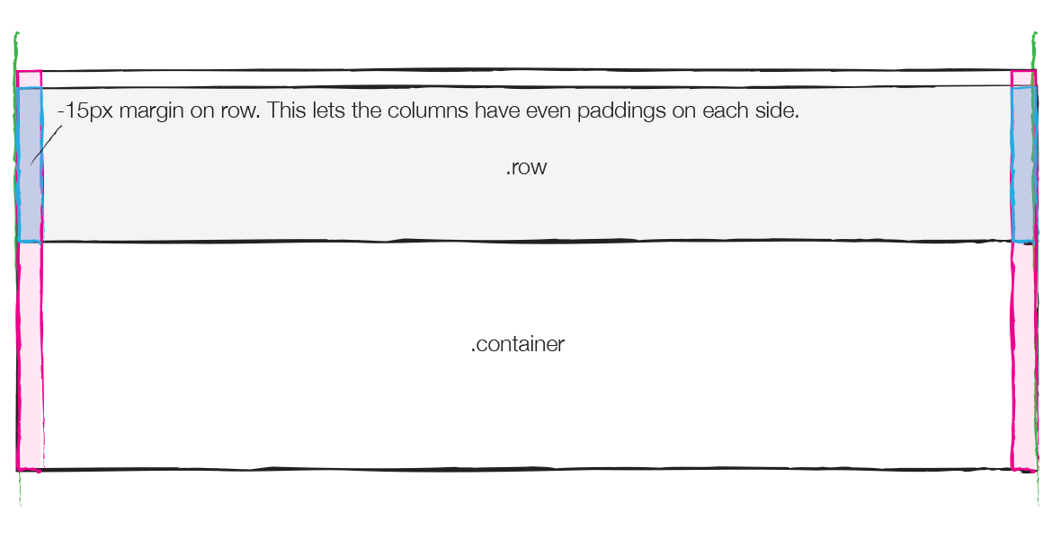
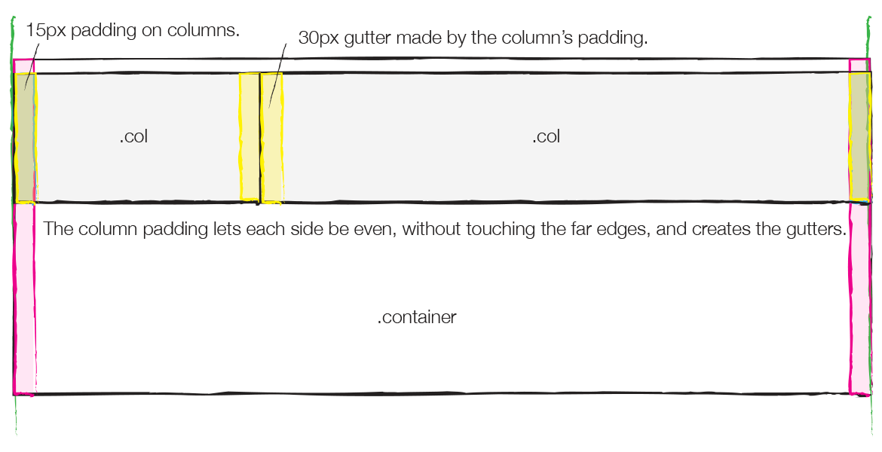
Bootstrap
A set of css classes that support responsive design as well as other typical operations.
Columns flow down when no room on screen.

Slide 10
Databinding
jQuery:
$(“#name”).text( model.name );
$(“#age”).text( model.age );
...
model.growOlder();
$(“#age”).text( model.age );
<div>
<span id=“name”/>
<span id=“age”/>
</div>
knockout.js (databinding):
ko.applyBindings( model );
...
model.growOlder();
<div>
<span data-bind=“text: name”/>
<span data-bind=“text: age”/>
</div>
Notes:
https://www.freelancinggig.com/blog/2018/07/23/whats-the-difference-between-knockout-js-and-jquery/
The most important feature of Knockout is its ability to bind the elements of UI to the data model in the simplest way. Using JavaScript or JQuery to manipulate DOM can sometimes lead to broken code in case you change the DOM hierarchy. It is very common in dynamic applications. With Knockout’s declarative binding, even when you change the hierarchy, the bindings stay the same. This feature is lacking in jQuery, and it is the sole reason for the rise of Knockout.js.
Read more at: https://www.freelancinggig.com/blog/2018/07/23/whats-the-difference-between-knockout-js-and-jquery/

Slide 11
Model View ViewModel
Model
View
ViewModel
Data (e.g. json)
{“people”:
[ “bob”, “stacy”,
“ashwin”]};
UI Element (DOM)
<ul/>
UI State, Behaviors, Triggers
Properties: Name
IsSelected, IsSorted, DisplayColor
OnClick Behavior.
OnHover Trigger.
Related Patterns: Fowler’s Presentation Model, also Model-View-Binder

Slide 12
Exercise - 2
Alone or with partner: Complete the example started here:
http://jsfiddle.net/mp2tyuha/4/
Hints:
Iterate with foreach: array
If no attribute, can use: $data
Add this.children.push
Get observable: this.personName()
Set observable: this.personName(“”)
Desired Output:

Slide 13
Solution:
http://jsfiddle.net/mp2tyuha/80/

